Slide 1


Thermal Analysis of Heat Distribution in Compressor Cylinder Fins
Members
Syed Saqib Ahmed | 4VV19ME137
Thushar K Nimbalkar | 4VV19ME140
Sumanth. B | 4VV19ME132
Mohammed Farhan | 4VV20ME425
Under the guidance of
Prof. Muthuraju N P
Mini Project Presentation – 18MEMP68 – 28-07-2022 Department of Mechanical Engineering Page 1

Slide 2
Introduction
Fins are surfaces that extend from an object to increase the rate of heat transfer to or from the environment by increasing convection.
The amount of conduction, convection, or radiation of an object determines the amount of heat it transfers.
Increasing the temperature gradient between the object and the environment, increasing the convection heat transfer coefficient, or increasing the surface area of the object.
Sometimes it is not feasible or economical to change the first two options.
Thus, adding a fin to an object increases the surface area and can sometimes be an economical solution to heat transfer problems
Mini Project Presentation – 18MEMP68 – 28-07-2022 Department of Mechanical Engineering Page 2

Slide 3
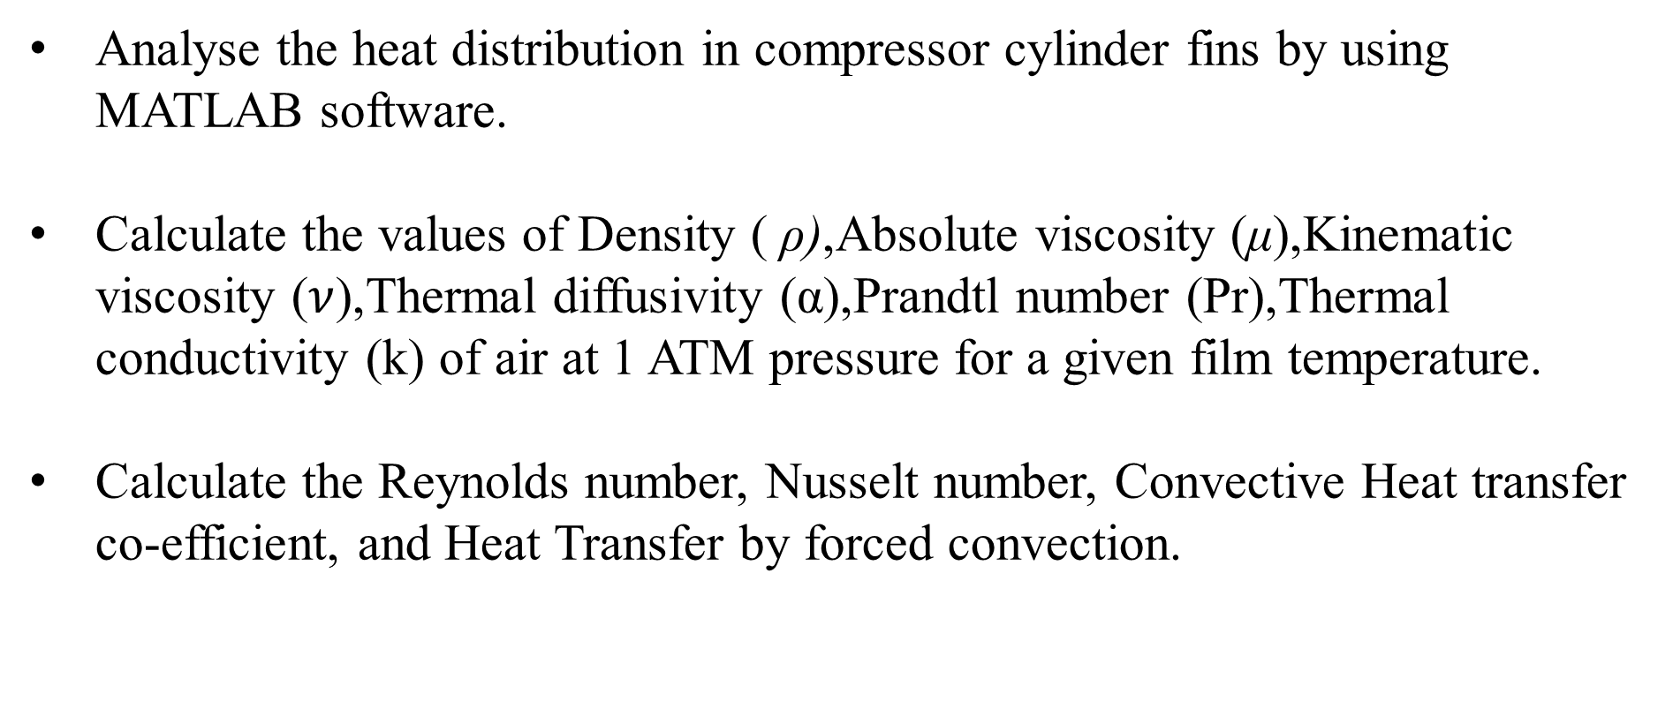
Problem Statement
Analyse the heat distribution in compressor cylinder fins by using MATLAB software.
Calculate the values of Density ( ρ),Absolute viscosity (μ),Kinematic viscosity ($ν$),Thermal diffusivity (α),Prandtl number (Pr),Thermal conductivity (k) of air at 1 ATM pressure for a given film temperature.
Calculate the Reynolds number, Nusselt number, Convective Heat transfer co-efficient, and Heat Transfer by forced convection.
Mini Project Presentation – 18MEMP68 – 28-07-2022 Department of Mechanical Engineering Page 3

Slide 4
Objectives
Increase the rate of heat transfer through fins by forced convection.
Apply and learn the fundamentals of MATLAB software.
Conduct the numerical analysis to validate against experimental values of temperature.
Compare and contrast the temperature distribution for different materials
Mini Project Presentation – 18MEMP68 – 28-07-2022 Department of Mechanical Engineering Page 4

Slide 5
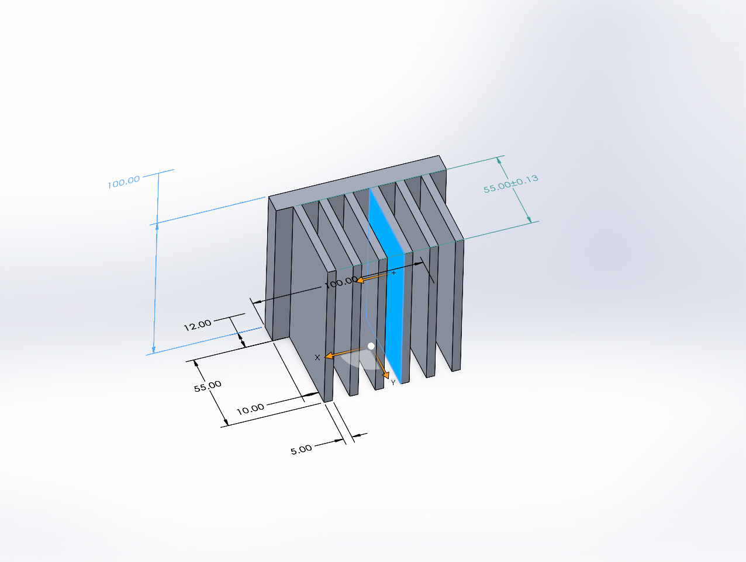
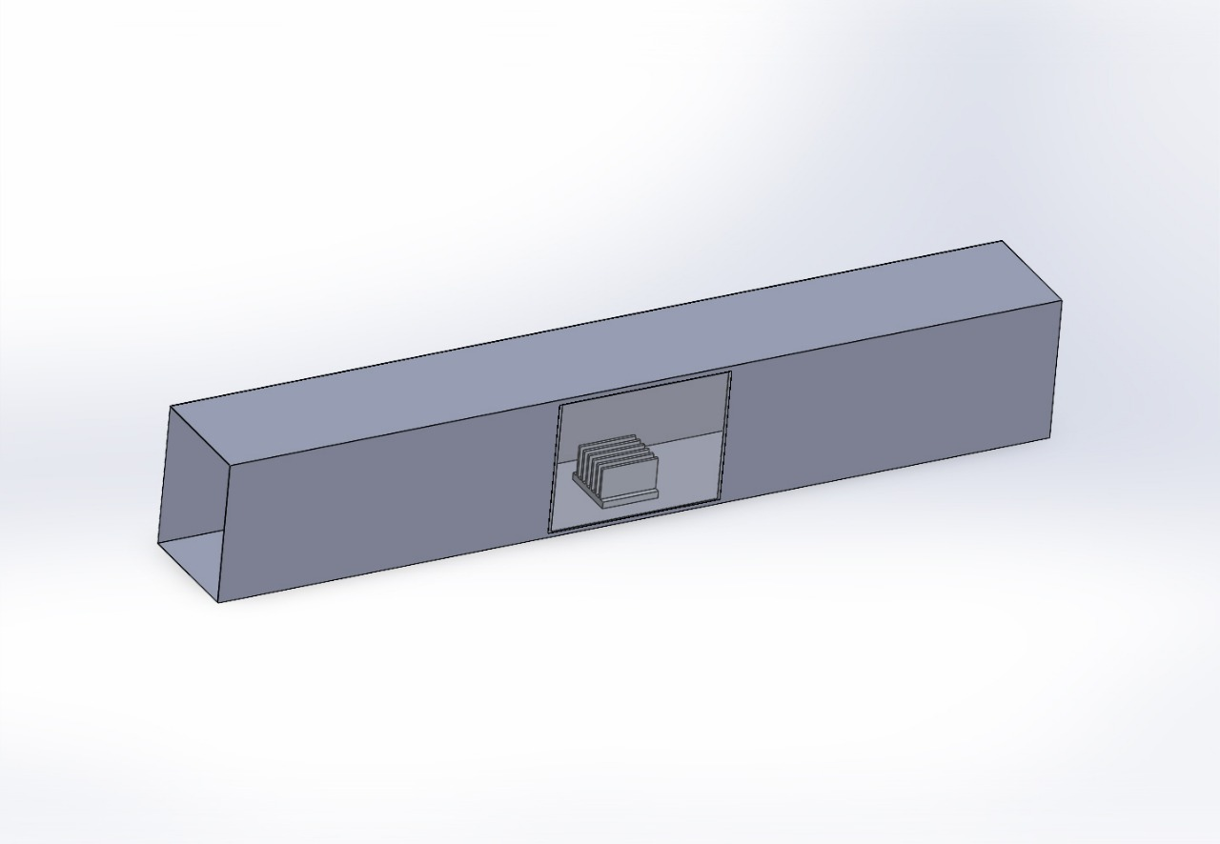
Proposed Sketch
Pitch | 10mm
Length | 55mm
Width | 100mm
Thickness | 5mm
Mini Project Presentation – 18MEMP68 – 28-07-2022 Department of Mechanical Engineering Page 5

Slide 6


Theoretical Calculations
T_{f} =$\frac{(T3+T4+T5+T6)}{4}$
T_{infi}= $\frac{T_{7}+T_{8}}{2}$
T_{m}=$\frac{T_{f+}T_{infi}}{2}$
T_{b}=$\frac{T_{1}+T_{2}}{2}$
R_{e}=$\frac{V∗L}{ν}$
N_{u} =0.332 $R_{e}^{0.5}$ ${\text{Pr} }^{0.333}$
h=$\frac{N_{u}∗k}{L}$
m=$\sqrt{\frac{h∗P}{k∗A}}$
Q_{fin} = ${(hPkA)}^{0.5}$*(T_{b}-T)*tanh(mL)
$\frac{\text{T}−\text{T}\text{infi}}{\text{T}\text{b}\text{−}\text{Tinfi} }$=$\frac{\text{c}\text{oshm}\text{(}\text{L}\text{−}\text{x}\text{)}}{\text{c}\text{osh}\text{(}\text{mL}\text{)}}$
Mini Project Presentation – 18MEMP68 – 28-07-2022 Department of Mechanical Engineering Page 6

Slide 7
Methodology
Taking the experimental readings of aluminium solid fin for varying velocity and heat.
Getting the correlations for air properties with respect to mean temperature.
Iterate the working in MATLAB to find the parameters and temperature distribution.
Validating the numerical temperature value with the experimental value.
Plot the graphs for temperature deviation and absolute mean deviation to find accuracy.
Mini Project Presentation – 18MEMP68 – 28-07-2022 Department of Mechanical Engineering Page 7

Slide 8
Correlations of properties of air
Mini Project Presentation – 18MEMP68 – 28-07-2022 Department of Mechanical Engineering Page 8

Slide 9
Correlations of properties of air
Mini Project Presentation – 18MEMP68 – 28-07-2022 Department of Mechanical Engineering Page 9

Slide 10
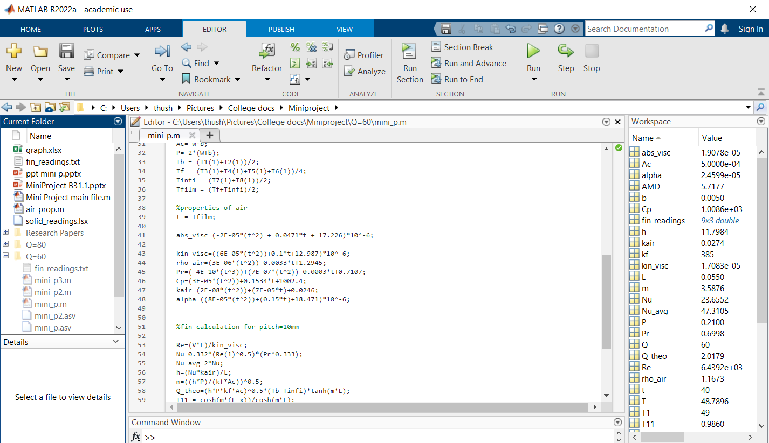
Numerical Analysis
Mini Project Presentation – 18MEMP68 – 28-07-2022 Department of Mechanical Engineering Page 10

Slide 11
Results and Observations
Q=60W,V=2m/s
Mini Project Presentation – 18MEMP68 – 28-07-2022 Department of Mechanical Engineering Page 11

Slide 12
Absolute Mean Deviation
Mini Project Presentation – 18MEMP68 – 28-07-2022 Department of Mechanical Engineering Page 12

Slide 13
Comparison of temperature distribution in Cu and Al fins
Material | Thermal Conductivity In W/mK | Density In Kg/m³ | Specific Heat in kJ/KgK | Melting Point in ⁰C | Latent Heat of Fusion in kJ/Kg | Thermal Expansion co-efficient in m⁰C
Copper | 385 | 8930 | 0.384 | 1084 | 206 | 17x10⁻⁶
Aluminum | 200 | 2700 | 0.897 | 660 | 396 | 23x10⁻⁶
Mini Project Presentation – 18MEMP68 – 28-07-2022 Department of Mechanical Engineering Page 13

Slide 14
References
Shinde Sandip Chandrakant, Shinde Sunilkumar and Nitin Gokhale, “Numerical and Experimental Analysis of Heat Transfer through Various types of Fin Profiles by Forced Convection”, International Journal of Engineering Research & Technology, ISSN: 2278 -0181, Vol. 2, Issue. 7, July. 2013, pp. 2493-2501
Ganesh B B, G V Naveen Prakash “Forced Convection Heat Transfer through the Rectangular Fins of Different Geometry of Perforations”, International Journal of Recent Technology and Engineering (IJRTE) ISSN: 2277-3878, Volume-8 Issue-1S2, May 2019.
Kavita H. Dhanawade, Vivek K. Sunnapwar and Hanamant S. Dhanawade, “Thermal Analysis of Square and Circular Perforated Fin Arrays by Forced Convection”, International Journal of Current Engineering and Technology, ISSN: 2277- 4106. Pp. 109-114.
C P Kothandaraman, S Subramanyan, Heat and Mass Transfer Data Hand Book.
Mini Project Presentation – 18MEMP68 – 28-07-2022 Department of Mechanical Engineering Page 14

